Slide 1

Is the World Health Organization (WHO) Influenced by Political Power?
Presented by: Evan Savaria
CS 895: Web Archiving Forensics
November 19, 2020

Slide 2
Outline
Introduction
2020 Contributions to the WHO
Timeline of Events Between United States and China
China’s president meets with WHO Director-General
No Evidence of Transmission
WHO Deletes Tweet on Whistleblower
Measures Deemed Ineffective Against COVID-19
United States Suspends WHO Support
Immunity Certificates Considered
Conclusions
Final Thoughts
Evan Savaria, 11/19/2020, Is the World Health Organization (WHO) influenced by Political Power?
2

Slide 3
Introduction
The World Heath Organization consists of 194 Member States, across six regions
Their mission is to keep the world safe, allow all peoples to attain the highest possible level of health, and promote human rights for all.
The WHO has be questioned for waiting months to declare the COVID-19 outbreak as a pandemic
The organization has been criticized in the news for showing favoritism towards China
Opinions of the World Health Organization are divided
https://www.who.int/countries/
https://www.jpost.com/international/the-whos-response-to-covid-19-reveals-its-political-bias-opinion-625233
https://www.newstatesman.com/science-tech/2020/03/why-did-world-health-organisation-wait-so-long-declare-coronavirus-pandemic
https://www.cnn.com/2020/02/14/asia/coronavirus-who-china-intl-hnk/index.html
Evan Savaria, 11/19/2020, Is the World Health Organization (WHO) influenced by Political Power?
3

Slide 4
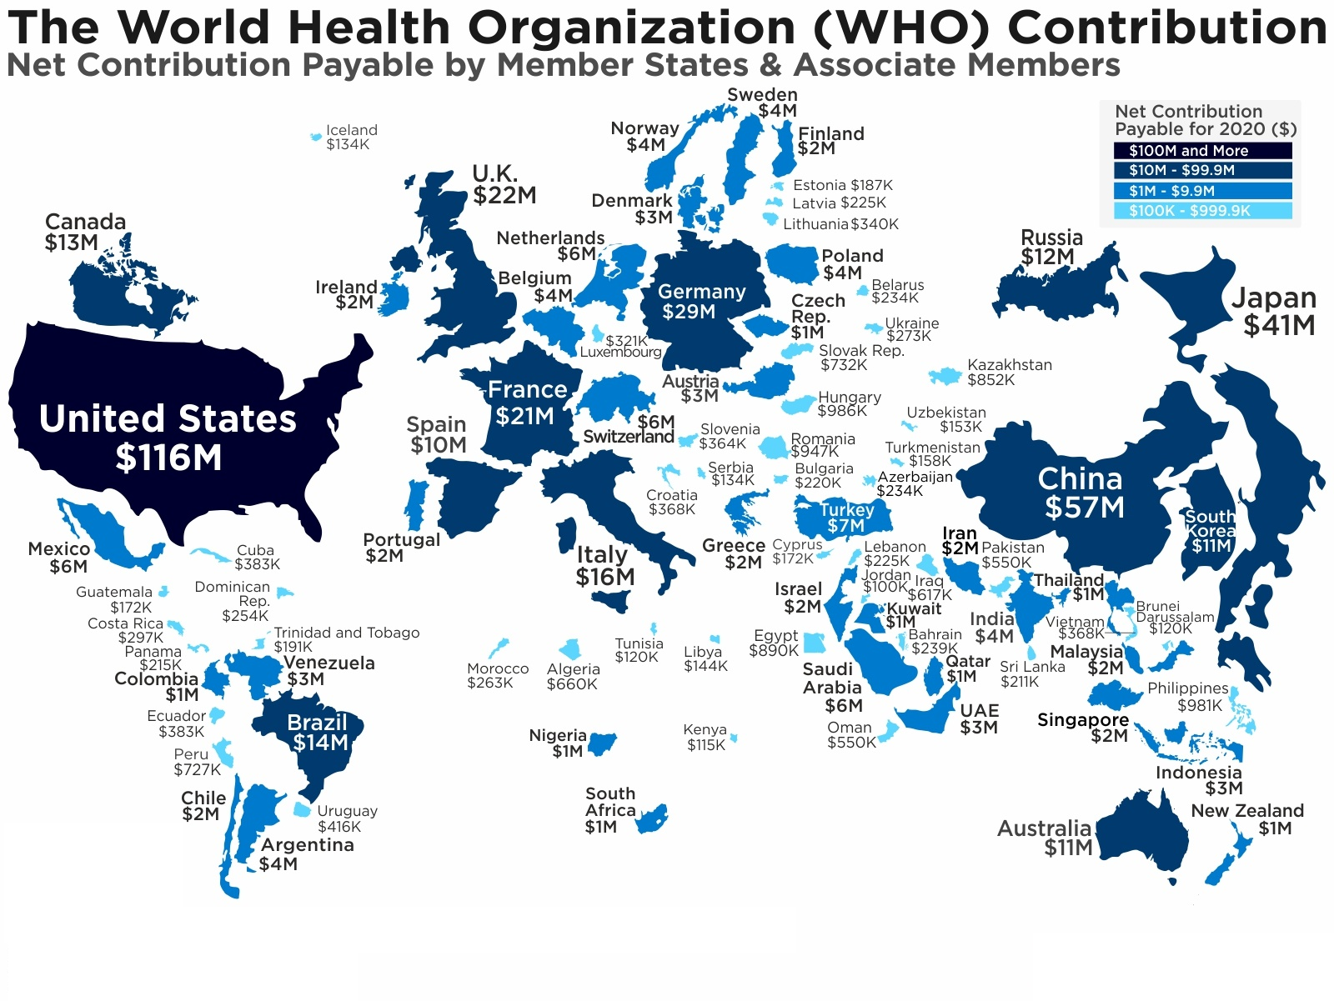
2020 Contributions to the World Health Organization
Top 10 Countries
1. U.S.: $116M (24% of total) 2. China: $57M (12% of total) 3. Japan: $41M (8% of total) 4. Germany: $29M (6% of total) 5. U.K.: $22M (4% of total) 6. France: $21M (4% of total) 7. Italy: $16M (3% of total) 8. Brazil: $14M (3% of total) 9. Canada: $13M (2% of total) 10. Russia: $12M (2% of total)
https://howmuch.net/articles/who-contribution
Evan Savaria, 11/19/2020, Is the World Health Organization (WHO) influenced by Political Power?
4

Slide 5

WHO Timeline of COVID-19 Events between United States and China
(First 6 months of Exposure)
2019-12-31
China Reports a group of pneumonia cases to the WHO
2020-04-10
United States considers immunity certificates
2020-01-30
WHO Congratulates China for Virus Containment
2020-04-23
China Donates $30M to Support the WHO
2020-02-07
China censors death of Dr. Li Wenliang on Weibo
2020-03-11
WHO announces COVID-19 a pandemic
2020-02-12
China promotes traditional Chinese Medicine and Western Medicine
2020-01-29
WHO Director-General Tedros Adhanom Ghebreyesus meets with Xi Jinping
2020-01-31
United States imposes travel restrictions
2020-03-07
WHO removes Herbal remedies from Measures Deemed Ineffective list
2020-04-15
United States suspends WHO financial support
2020-04-24
WHO deletes Tweet warning about reinfection
uncertainty
2020-01-14
WHO states no evidence of human-human transmission
2020-02-07
WHO deletes Tweet Recognizing Death of Dr. Li Wenliang
Evan Savaria, 11/19/2020, Is the World Health Organization (WHO) influenced by Political Power?
5

Slide 6
China Reports a Group of Pneumonia Cases to the WHO
On December 31, 2019 the WHO office located in China was informed of several cases regarding an unknown form of pneumonia
The organization reported there was no evidence of human to human transmission
Unable to make a risk assessment due to limited information
At that time the WHO did not recommend specific travel measures and advised against travel and trade restrictions on China
https://www.who.int/csr/don/05-january-2020-pneumonia-of-unkown-cause-china/en/
Evan Savaria, 11/19/2020, Is the World Health Organization (WHO) influenced by Political Power?
6

Slide 7
WHO Director-General Tedros Adhanom Ghebreyesus meets with Xi Jinping
China’s president Xi Jinping met with World Health Organization Director-General Tedros Adhanom Ghebreyesus in Beijing on January 29, 2020
Xi explains the Chinese government has been timely, open, and transparent about the virus and welcomes the WHO to participate in the containment effort
Tedros states that the WHO firmly supports China’s measures against the virus and is ready to cooperate with China to provide assistance
Tedros speaks highly of China’s role and contribution to global public health
https://www.fmprc.gov.cn/mfa_eng/zxxx_662805/t1737014.shtml
Evan Savaria, 11/19/2020, Is the World Health Organization (WHO) influenced by Political Power?
7

Slide 8
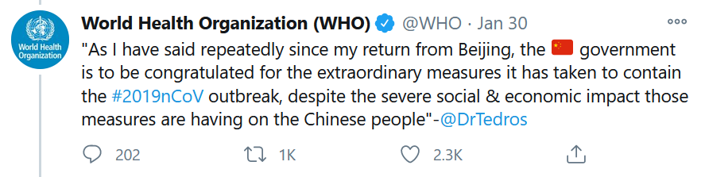
WHO Congratulates China for Virus Containment after Visit
After Tedros Ghebreyesus met with Xi in January, he posted a tweet describing the great success China had containing the virus
Over a month later WHO describes COVID-19 as being widespread and characterized the spread as a pandemic
https://twitter.com/WHO/status/1222968023876763649
2020-03-11: WHO makes an assessment that COVID-19 could be characterized as a pandemic
Evan Savaria, 11/19/2020, Is the World Health Organization (WHO) influenced by Political Power?
8

Slide 9
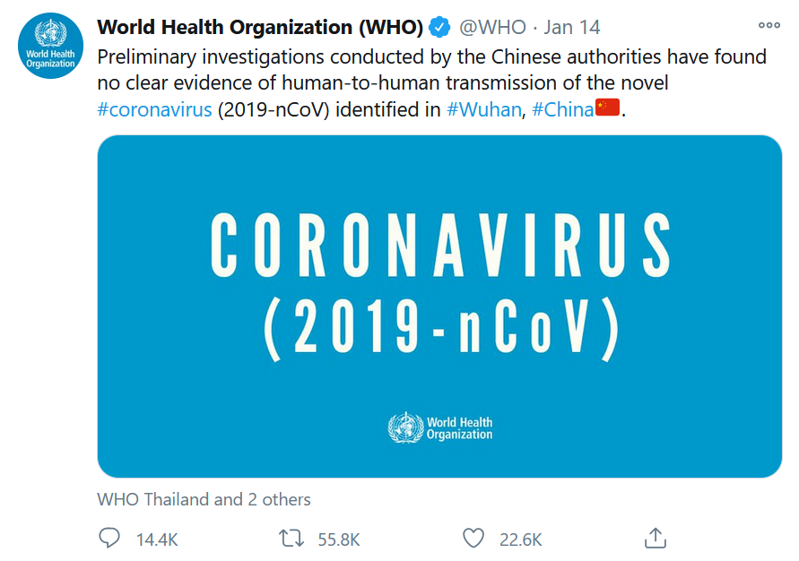
No Evidence of Human-Human Transmission
On January 14, 2020 WHO did not recognize the spread of the virus as a global emergency
The spread of the virus was an emergency in China
https://twitter.com/who/status/1217043229427761152?lang=en
Evan Savaria, 11/19/2020, Is the World Health Organization (WHO) influenced by Political Power?
9

Slide 10

United States Imposes Travel Restrictions
On January 31, 2020 the United States blocks travel from China
The order became effective on February 2nd
Secretary of Health and Human Services Alex Azar declares the coronavirus a public health emergency
https://www.whitehouse.gov/presidential-actions/proclamation-suspension-entry-immigrants-nonimmigrants-persons-pose-risk-transmitting-2019-novel-coronavirus/
Evan Savaria, 11/19/2020, Is the World Health Organization (WHO) influenced by Political Power?
10

Slide 11
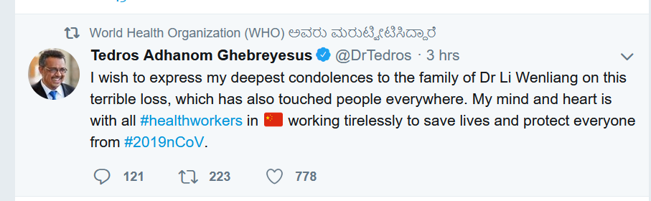
WHO Deletes Tweet Recognizing Death of Whistleblower
On 2020-12-30, Dr. Li Wenliang wrote to a group of medical colleagues on “WeChat” that seven cases of a SARS-like pneumonia had been confirmed
Months later he died on 2020-02-07
WHO expressed sadness for the loss of Dr. Li Wenliang but later deleted the tweet
Concurrently, the Chinese state deleted any messages about Li’s death from the internet
https://web.archive.org/web/20200207174020if_/https://twitter.com/WHO
Evan Savaria, 11/19/2020, Is the World Health Organization (WHO) influenced by Political Power?
11

Slide 12
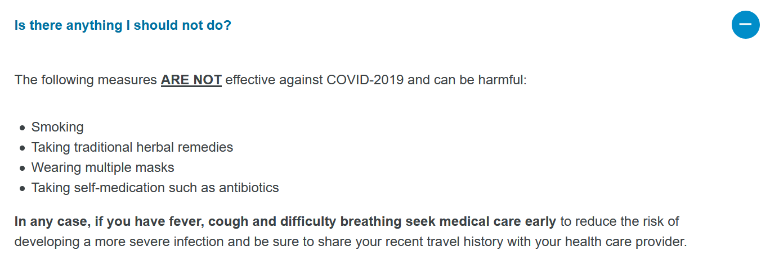
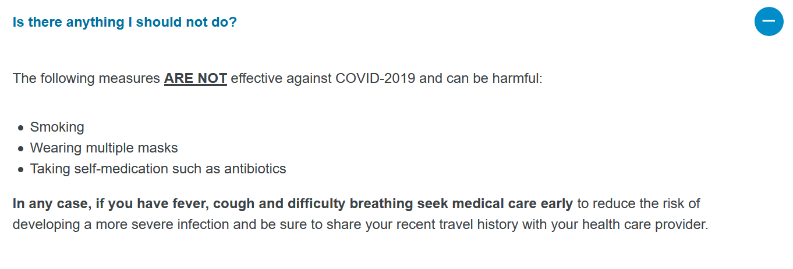
Measures Deemed Ineffective Against COVID-19
March 03, 2020: The National Health Commission of China (NHC) released Diagnosis and Treatment Protocol for Covid-19 which made modifications in the determination of transmission routes and clinical symptoms, updated diagnostic criteria, and emphasized the integration of traditional Chinese medicine and Western medicine in treating the disease
http://en.people.cn/n3/2020/0213/c90000-9657268.html
Chinese Covid-19 Q&A List
2020-03-05: Herbal remedies were deemed not effective against Covid-19 by WHO
2020-03-06: Herbal remedies were then removed from the list
English Covid-19 Q&A List
2020-03-07: Herbal remedies were deemed not effective against Covid-19 by WHO
2020-03-08: Herbal remedies were then removed from the list
Changing the Q&A list and doing so on China’s first suggests WHO did not want to contradict the president of China
http://web.archive.org/web/20200307012710/https://www.who.int/news-room/q-a-detail/q-a-coronaviruses
http://web.archive.org/web/20200308012752/https://www.who.int/news-room/q-a-detail/q-a-coronaviruses
Evan Savaria, 11/19/2020, Is the World Health Organization (WHO) influenced by Political Power?
12

Slide 13
United States Suspends WHO Financial Support
On April 15, 2020 the United States said they would halt funding to the World Health Organization because it failed in basic duty in response to the pandemic
The President Donald Trump accused the WHO of having being biased towards China
The United States gave $400 Million in 2019 to the WHO
Many criticized the presidents actions of halting funding during a world health crisis
https://www.bbc.com/news/world-us-canada-52289056
Evan Savaria, 11/19/2020, Is the World Health Organization (WHO) influenced by Political Power?
13

Slide 14
China Makes $30M Donation to WHO
On April 23, 2020, China announces a donation of $30 million to the World Health Organization
This pledge was announced a week after U.S. President Donald Trump accused the WHO of promoting Chinese disinformation
China’s spokeswoman explains supporting the WHO is supporting multilateralism and global solidarity
Tedros Adhanom Ghebreyesus responds to the Trump Administration during a virtual briefing, “I hope the U.S. believes that this an important investment, not just to help others, but for the U.S. to stay safe also”
https://www.reuters.com/article/us-health-coronavirus-china-who/china-pledges-30-million-more-for-whos-coronavirus-fight-idUSKCN2250VM
Evan Savaria, 11/19/2020, Is the World Health Organization (WHO) influenced by Political Power?
14

Slide 15
United States Considers Immunity Certificates
On April 10, 2020 Dr. Fauci explains immunity certificates may have some merit under certain circumstances
This effort will assist in knowing who is vulnerable or not
An antibody test would decide eligibility for the certificate
Anti-body tests would become available in the following weeks
https://www.cnn.com/world/live-news/coronavirus-pandemic-04-10-20/h_22356f654296c004330e2149b8afd5eb
Evan Savaria, 11/19/2020, Is the World Health Organization (WHO) influenced by Political Power?
15

Slide 16
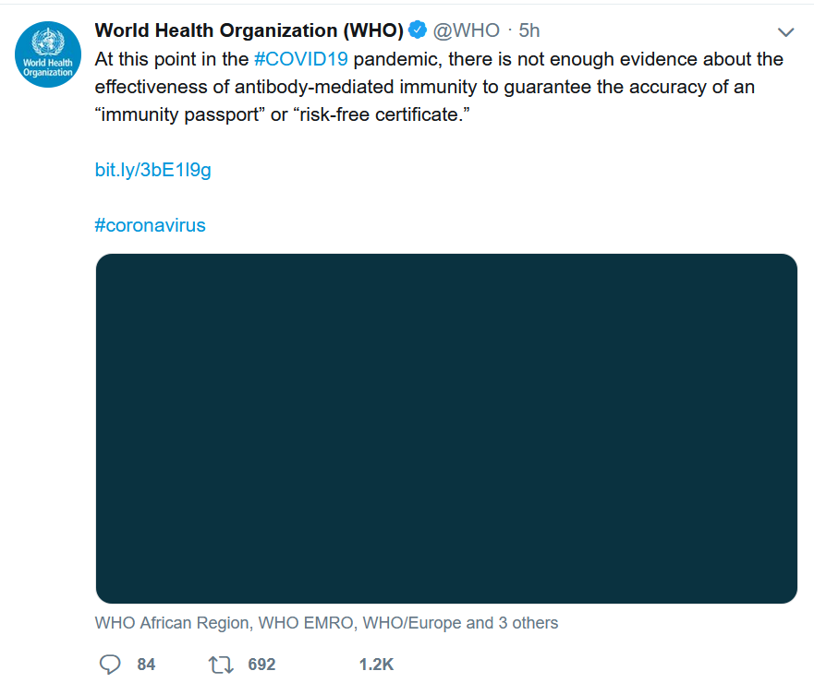
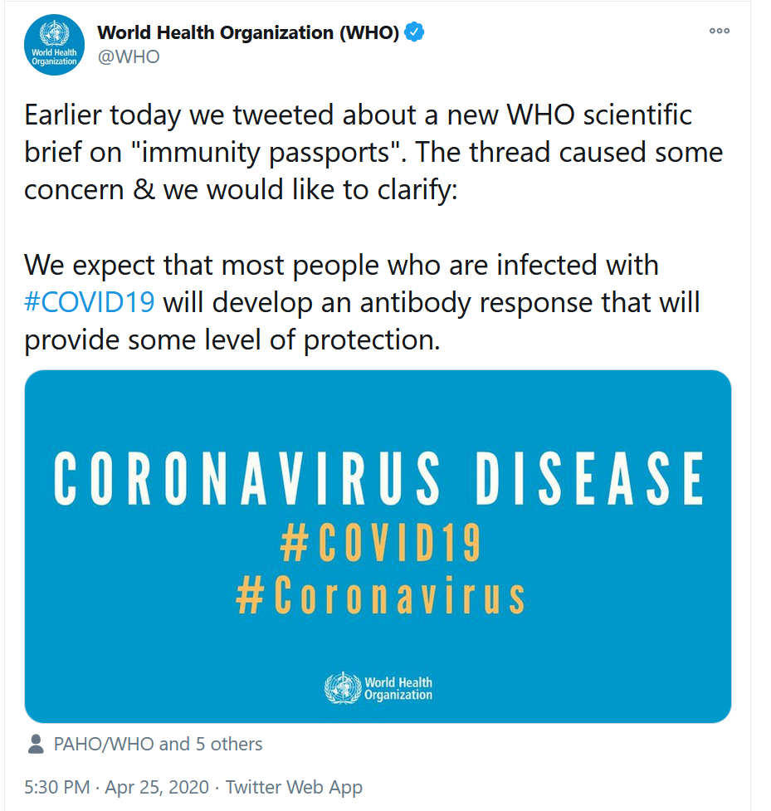
WHO Tweet Warning About Reinfection
https://web.archive.org/web/20200425183010if_/https://twitter.com/WHO
https://twitter.com/WHO/status/1254160937805926405
The Tweet on the left was deleted later in the day since there was no definitive proof about a reinfection outcome
The Tweet on the right provided clarity
Evan Savaria, 11/19/2020, Is the World Health Organization (WHO) influenced by Political Power?
16

Slide 17
Conclusion
We discussed (6) potential actions influenced by political power between the WHO, United States, and China
2020-01-29/2020-01-30: Director-General of WHO meets with Xi Jinping in Beijing and then recognizes China on Twitter for virus containment
2020-01-14/2020-01-31: WHO does not claim human-human transmission and the United States imposes travel restrictions
2020-02-07: China censors death of Dr. Li Wenliang and WHO deletes Tweet recognizing his death
2020-02-12/2020-03-07: China promotes Chinese traditional medicine (TCM) and WHO removes herbal remedies from list of ineffective measures for treating COVID-19
2020-04-15/2020-04-23: United States suspends WHO financial support and China donates $30 million to support WHO
2020-04-10/2020-04-24: The United States considers immunity certificates and the WHO deletes tweet warning about uncertainty of reinfections
Evan Savaria, 11/19/2020, Is the World Health Organization (WHO) influenced by Political Power?
17

Slide 18
Final Thoughts
Challenges between country leaders does affect how the World Health Organization operates and is viewed globally
The deleted tweets were validated through use of the Internet Archive
The tweets can also be linked to other events within this timeline between the United States and China
United States and China need to demonstrate leadership and find a way to work together to combat the coronavirus
Should not defund the World Health Organization during a pandemic
President-elect Joe Biden plans to rejoin the WHO on 2021-01-20
Evan Savaria, 11/19/2020, Is the World Health Organization (WHO) influenced by Political Power?
18

